Slide 1
Processed Kimberlite to Mine
Workings - Scoping Meeting
Introduction and Project Overview
Sean Sinclair, Environment Superintendent
Template #: DCON-029-1010 R8

Slide 2
Presentation Outline
Introduction and Project Overview
Water Quality Modelling Approach
Scope of the Environmental Assessment

Slide 3
Diavik Team
Sean Sinclair – Environment Superintendent
Gord Macdonald – Closure Manager
Kofi Boa-Antwi – Regulatory Advisor
Mark Nelson – Environment Advisor

Slide 4
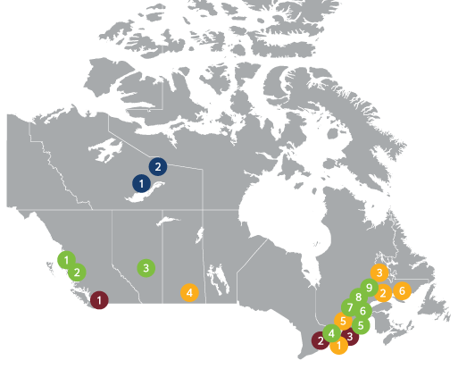
Rio Tinto in Canada
Aluminum
Energy & Minerals
Copper & Diamonds
Rio Tinto Corporate Support Offices
Supporting a team of 15 000
35 sites across the country
Producing the materials essential for human progress
Montreal recently named one of the company’s three global hubs
Rio Tinto Operations in Canada
4

Slide 5
The Diavik diamond mine
Rio Tinto Operations in Canada
5

Slide 6
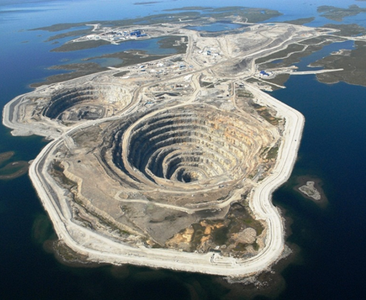
Diavik at a glance
Located at Lac de Gras approximately 300 km northeast of Yellowknife
Joint Venture: 60% Rio Tinto (owner and operator) and 40% Dominion Diamond Mines (acquired by The Washington Companies)
~1,100 employees including contractors
5 local Indigenous groups
Discovered in 1995, operations commenced in 2003
Produces around 6-7 million carats per annum
Over 100 million carats produced since 2003
The current mine plan has production ending in 2025
6

Slide 7
Bringing the two billion year old gems to the surface
Four kimberlite pipes mined using open pit and underground mining methods
A154 North
A154 South
A418
A21
Above ground processing plant has a ~2.4 million tonne capacity
In Yellowknife, we clean and sort Diavik rough diamonds for their onward sales and marketing journey

Slide 8
Regulatory Approvals / Authorizations for the Diavik Diamond Mine Project
Approvals/Authorizations for Diavik to date not limited to the following:
Canadian Environmental Assessment Act Approval
Environmental Agreement
Surface Leases
Fisheries Act Authorizations
Navigation Protection Act Approvals
Water Licence

Slide 9
Purpose of the Proposal / Application
To request an amendment to the Water Licence to permit the option of deposition of Processed Kimberlite (PK) material into Mine Workings (A418, A154, and A21 pits)
“Mine Workings” means the underground and/or open pit area resulting from the development of an ore body
Mackenzie Valley Environmental Impact Review Board is conducting an environmental assessment (EA) on the Proposal

Slide 10
PK Production and Storage
Based on the current mine plan, the PKC will be full in 2021 without additional dam raise beyond current approvals
Underground mining of the A154S and A418 kimberlite pipes will be completed by 2022
Underground mining of the A154N kimberlite pipe will be completed in 2025
Open pit mining of the A21 kimberlite pipe will be completed by 2023

Slide 11
Current PK Storage
Processed kimberlite is currently stored within the Processed Kimberlite Containment (PKC) Facility
The PKC Facility is surrounded by a lined dam that DDMI has constructed and made higher over the years
The amount of storage area left within the PKC will not fit the amount of processed kimberlite that will be produced during the remaining years of mining
PKC dam expansion opportunities are limited by the size of East Island

Slide 12
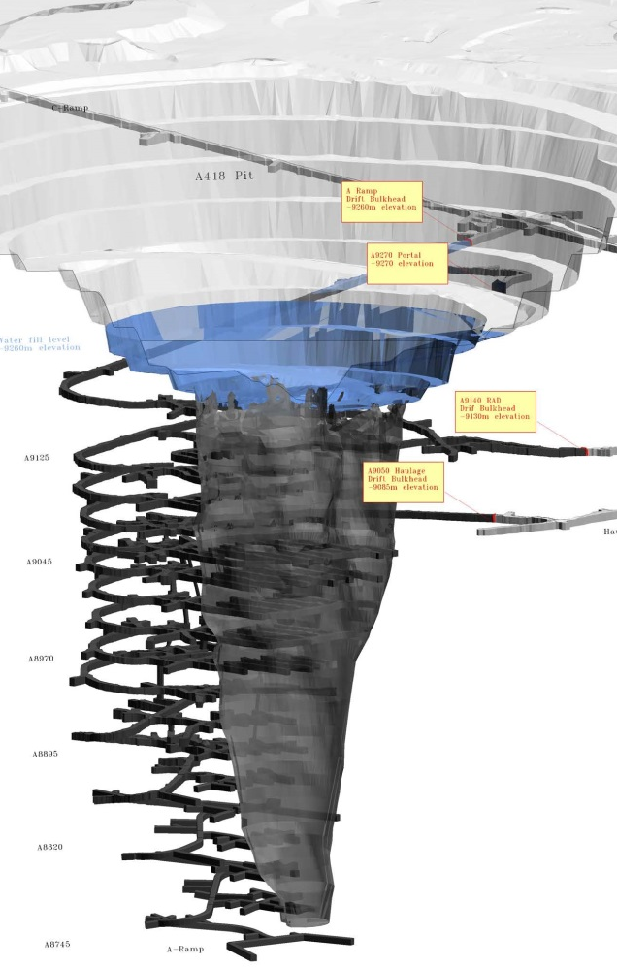
Conceptual Drawings for A418
Deposition strategy to be finalized and included in Processed Kimberlite Containment in Mine Workings Design Report

Slide 13
Benefits of the Deposition of PK to Mine Workings
Improves health and safety related to operations and closure
Reduces environmental risks related to PK storage
Ensures certainty in PK storage capacity for the life-of-mine
Enhances operational flexibility
Reduces capital expenditures for the life-of-mine
Reduces closure risks

Slide 14
Assessment of Potential Environmental Risks and Impacts
Assessed the potential for adverse impacts to biotic and abiotic components, including water quality and fish and fish habitat
Assessment based on robust data from site specific studies, literature review, and Traditional Knowledge
Assessed operational, health and safety, and environmental risks, including the potential for accidents and malfunctions

Slide 15
Assessment of Potential Environmental Risks and Impacts
Applied credible assumptions where scientific uncertainty exists
Applied conservatism and the precautionary approach
Certainty and confidence in results informed by ongoing operations and on modelling
Monitoring programs and adaptive management

Slide 16
Assessment of Potential Environmental Risks and Impacts
Committed to protecting the health and safety of workers and the environment in executing the proposal
Committed to ensuring PK to Mine Workings does not result in significant adverse impacts to the environment

Slide 17
Stakeholder Engagement
Proposed PK to Mine Workings informed by DDMI’s ongoing engagement with stakeholders
PK to Mine Workings addresses concerns regarding the long-term stability and environmental risks of the Processed Kimberlite Facility
Engaged stakeholders on potential impacts, proposed mitigation measures, the acceptability of residual impacts, and how mitigation might be enhanced

Slide 18
Stakeholder Support
Broad support for the Proposal among our Participation Agreement partners and communities
PK to Mine Workings not likely to be a cause of significant public concern

Slide 19
Alternatives Assessment / Options Analysis
Option | Key Advantages | Key Disadvantages
1. Traditional Dam Raise | permitted known approach | high cost footprint restrictions new construction necessary limited closure options
2. A418 Deposition with Current Dam Height | lower cost maximum use of existing storage capacity no new dam construction enhanced closure options | license amendment high risk of running out of PKC storage before A418 is available.
3. Additional On-Site Storage | no new dam construction lowest cost enhanced use of existing facilities | loss of original facility functionality license amendment site runoff risk expanded closure footprint
4. PKC Dam Raise and A418 Deposition | limits risk of running out of storage space maximize use of existing storage capacity enhanced closure options | moderate cost new dam construction necessary license amendment
Four (4) options considered as part of preliminary studies:
Life of Mine (LOM) PK storage through traditional dam raise.
LOM PK storage through current PKC dam height and deposition to mine workings.
LOM PK storage through current PLC dam height and alternative onsite storage options.
Combination of PKC dam raise and deposition to mine workings (Preferred Option).

Slide 20
Processed Kimberlite to Mine
Workings - Scoping Meeting
Water Quality Modelling Approach
Gord Macdonald, Closure Manager
Template #: DCON-029-1010 R8

Slide 21
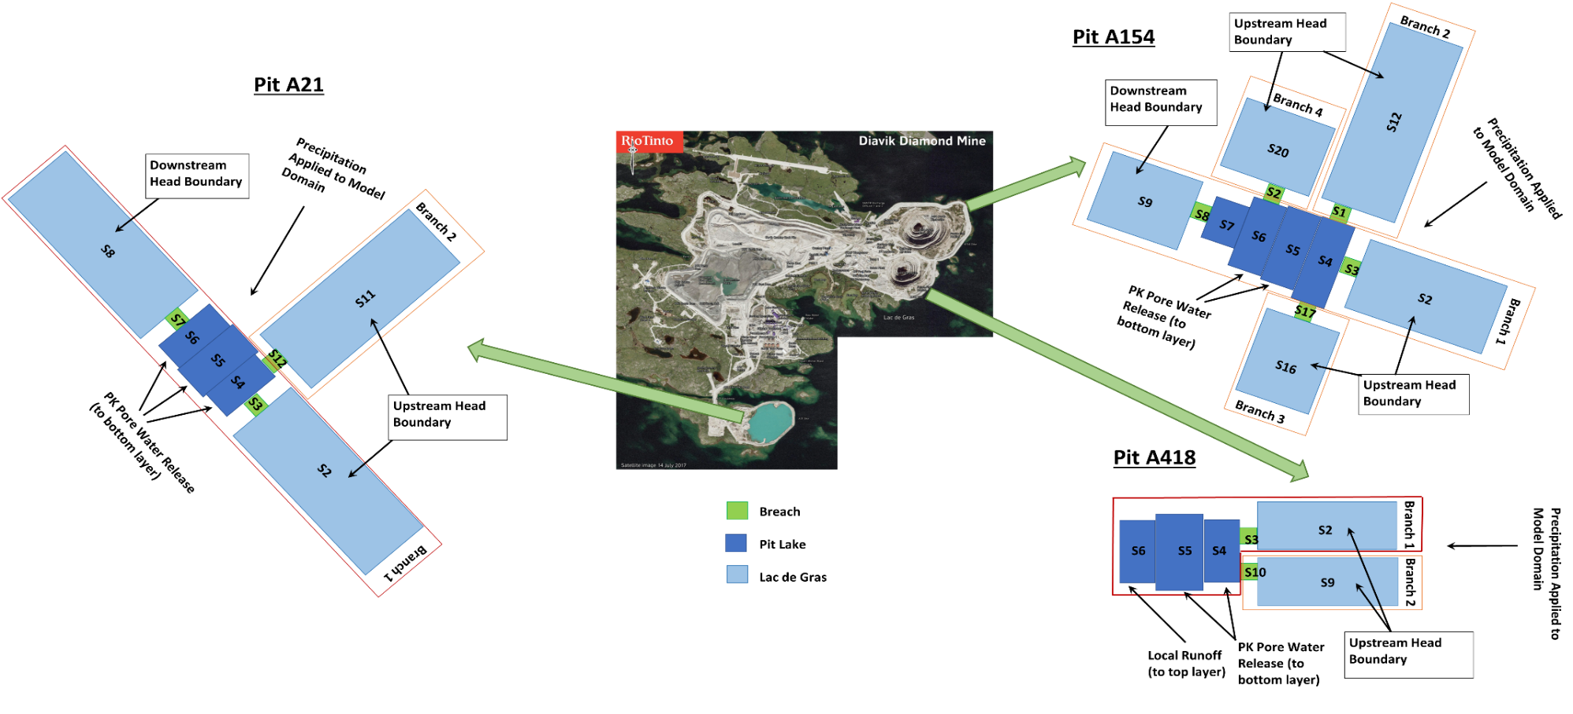
Water Quality Modelling Approach
CE-QUAL-W2: a two dimensional, laterally averaged, hydrodynamic, and water quality model

Slide 22
Processed Kimberlite Deposition into Mine Workings
Conceptual model – consolidation & pore water release over time
As conceptualized
As modelled

Slide 23
Pit Lake Modelling Results¹
Surface water quality remains below Benchmarks and similar to Lac de Gras
Parameters | Unit | AEMP Benchmark | Lac de Gras² | Scenario 2-a | Scenario 3-a | Scenario 4-a
 |  |  |  | at Depth of 40 m Below Surface | at Depth of 40 m Below Surface | at Depth of 40 m Below Surface
Chloride | mg/L | 120 | 1.9 - 5.2 | 3.5 | 3.7 | 3.5
Sulfate | mg/L | 100 | 2.19 - 5.47 | 4.0 | 4.7 | 4.0
Nitrate as nitrogen | mg/L | 3 | 0.001 - 0.105 | 0.063 | 0.12 | 0.064
Aluminum | μg/L | 87 | 4.46 - 9.74 | 6.3 | 6.3 | 6.3
Arsenic | μg/L | 5 | 0.202 - 0.401 | 0.28 | 0.3 | 0.28
Cadmium | μg/L | 0.1 | 0.0025 - 0.0054 | 0.0029 | 0.0042 | 0.0029
Copper | μg/L | 2 | 0.5 - 0.661 | 0.59 | 0.6 | 0.59
Lead | μg/L | 1 | 0.0025 - 0.007 | 0.0035 | 0.0048 | 0.0035
Molybdenum | μg/L | 73 | 0.265 - 2.79 | 0.99 | 2.1 | 1.0
Nickel | μg/L | 25 | 0.642 - 0.886 | 0.77 | 0.79 | 0.77
Uranium | μg/L | 15 | 0.092 - 0.157 | 0.12 | 0.12 | 0.12
Zinc | μg/L | 30 | 0.11 - 0.38 | 0.21 | 0.48 | 0.21
2a – 5.0 Mm³ deposited PK
3a – 5.0 Mm3 deposited PK plus 5.0 Mm³ of dredged PK slimes
4a – Scenario 2a but with initial decant water level at 15m vs 5m
Results for A418 taken from response to Technical Session IR-5
Range of measured concentrations at AEMP MF3-1 and MF3-2 (DDMI 2017)

Slide 24
Processed Kimberlite to Mine
Workings - Scoping Meeting
Scope of the EA
Kofi Boa-Antwi, Regulatory Advisor
Template #: DCON-029-1010 R8

Slide 25
Scope of the Environmental Assessment
EA to focus on the Closure Phase
EA scope to be for storage of PK in mine workings
An unanticipated mixing event to be considered within “Accidents and Malfunctions”
Effects Criteria and Significance to be as defined in the Comprehensive Study Report (1999) for the Diavik Diamond Mine Project

Slide 26
Scope of the Environmental Assessment, cont’d
Wildlife effects assessment to be limited to Caribou
“Cultural use of the area post-closure” relates to fishing and/or drinking of water within pit lakes and Lac de Gras
No requirement to develop additional baseline data – will reference existing data used in previous assessments
Cumulative impacts will only be considered where there are residual impacts

Slide 27
Questions?

